Slide 1


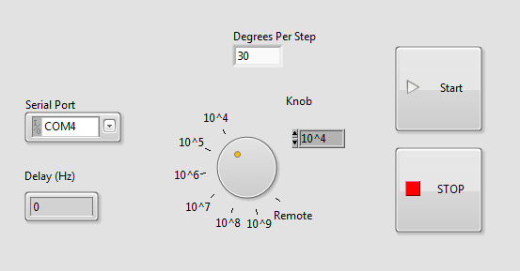
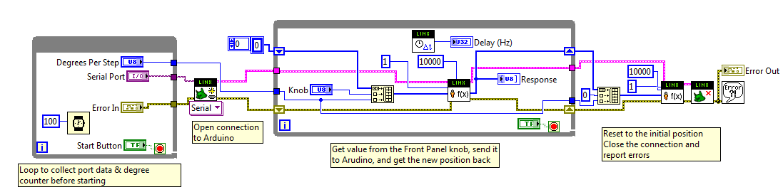
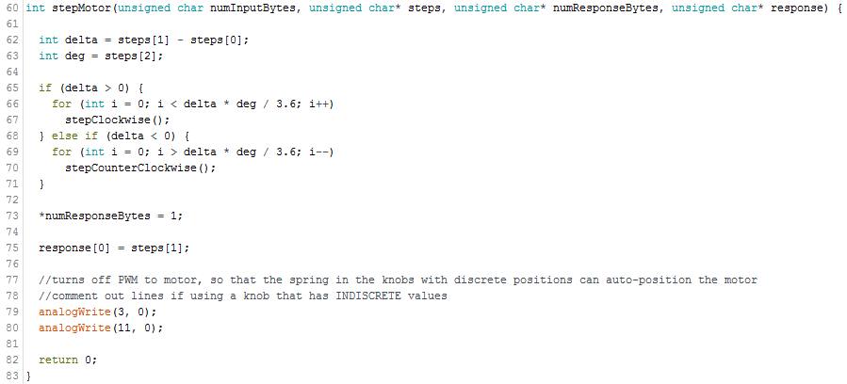


Remote Control of Experiments: Upgrading Legacy Equipment
Aleksandar Antic, UC San Diego
National Institute of Standards and Technology, Gaithersburg, Maryland 20899
Abstract
Many experiments depend on several pieces of equipment with rotary switches, sometimes in extremely difficult-to-access locations. Though many legacy instruments have modern versions that are controllable through computers, those pieces of equipment can cost thousands of dollars to purchase. Simple automation of the old instruments provides a cheap and simple alternative to a full upgrade. Though not currently applicable to all scenarios, this proof of concept can be modified in the future.
Code Snippets
VI Front Panel
Applications
This robot can be used for any knob that requires adjustments of less than 3.6°, as the motor cannot step more accurately. For a more acute adjustment, a DC motor with an encoder would function a lot better, but would have a much lower pull-in torque, and may not be able to actually move the dials.
Integrating Sphere – Gain Adjustment
LabVIEW Block Diagram
Custom Arduino Firmware
Current Amplification
Reproduction
The list of necessary parts, CAD files, and all code to make a duplicate model are available at: https://github.com/alek-antic/ideal-robot/
Custom firmware for the Arduino was used in order to properly interface the electronics with the LINX software package for LabVIEW. Without this firmware, there would be no way to control the stepper motor from the VI. Furthermore, this allows use on any system, without having to upload any code to the board when transferring computers.
Use
Remove the actual knob from the axle, replace it with a gear, and tighten the set screw. Velcro down the frame, such that the gear on the stepper interlocks with the gear on the knob. Plug in the Arduino to the computer and run the VI.
Limitations
Knobs mounted on vertical panels (i.e. equipment racks) cannot currently be automated, as the glue on the Velcro used to mount the motor is extremely weak, and may not hold the assembly against the wall well enough. Also, some knobs that are more stiff may require a motor with more torque, different sizes of gears, or external power sources (9V battery).
Possible Improvements
A way to sense directly the position, possible with encoder
Build a case for the Arduino board
Create networking VI to allow even further remote control of instruments
Use of pulleys instead of gears for systems that require even longer extensions
Schematic
Stepper
Arduino
Gear System
Knob
Acknowledgements
Thank you to Thomas Larason for sponsoring me and giving me this project this summer, as well as Matt Staymates for providing the motors and helping with 3d printed prototypes. Many thanks to Alan Migdall and Cameron Miller for their ideas and support throughout the project.

